Slide 1
sPHENIX PCB

Slide 2
Our PCB
Printable Circuit Board
Using it to create stripes of copper, which will induce an electric field to push the electrons down the drift chamber.
5 identical segments
Each segment will consist of 2 sets of 298 1206 resistors (3.2x1.6mm)
To go on the inside of the TPC chamber
Double sided
Printed by the company AllFlex

Slide 3
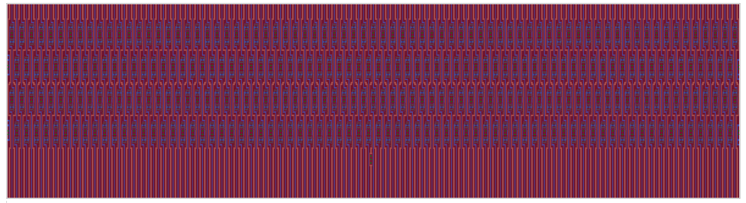
Each segment will be approximately 16.5 inches wide, and will go around the inner circumference of the chamber (around 5m)

Slide 4
One set of resistors

Slide 5
Some of the different stripes
A, B, C, D
A and B are only on the top layer
C and D are bottom stripes with connections to the top layer
VCC, GND, Pre, and Post
VCC and GND are the beginning and end stripes of the top layer
Pre and post are the beginning and end stripes of the bottom layer
MagicA, MagicC, MagicD
Special shapes to create the terminal used to power the board

Slide 6
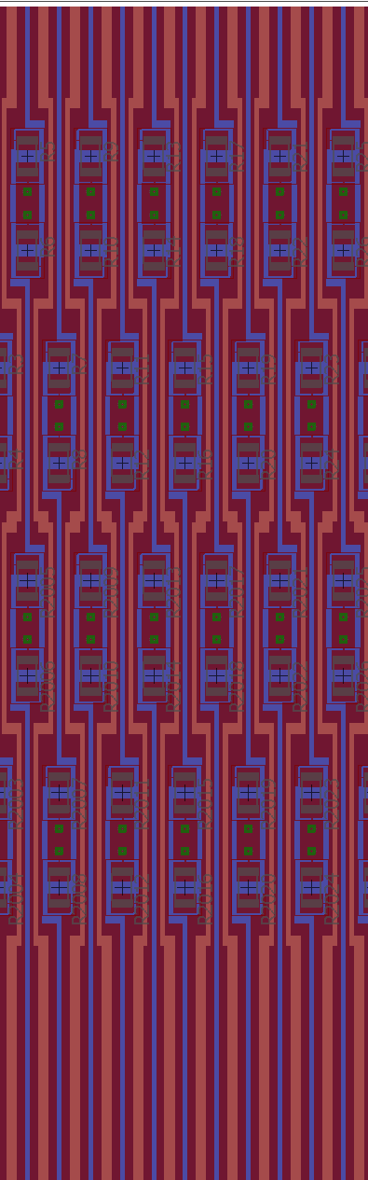
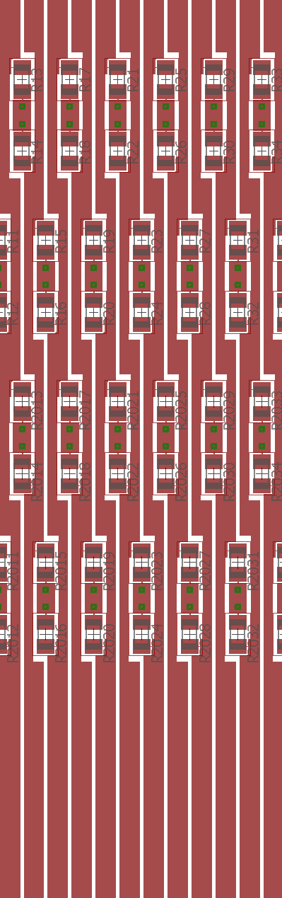
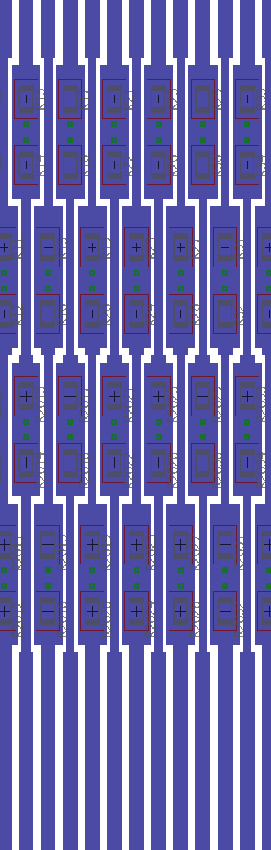

Slide 7
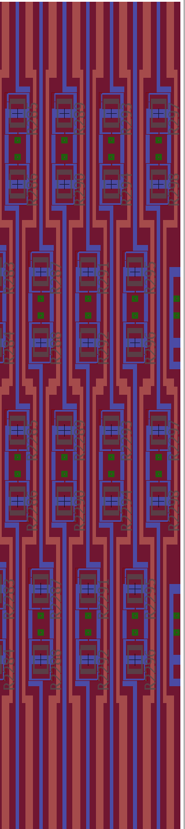
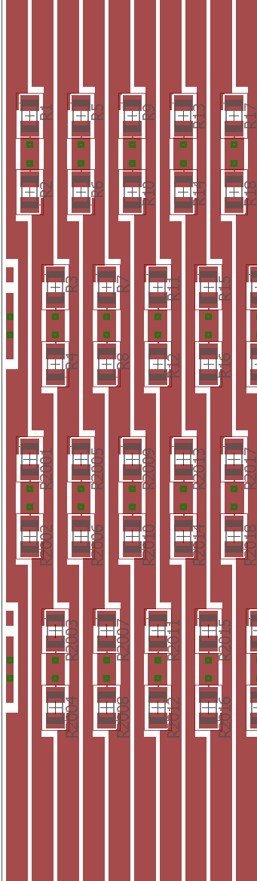
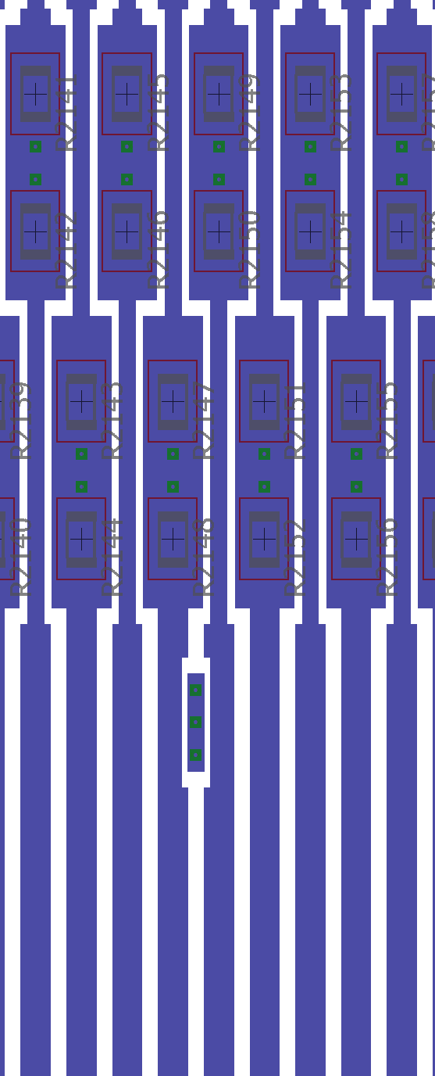

Slide 8
How it was accomplished
Cadsoft’s PCB design software Eagle
Variable manipulation by using a program which was written in C++
A lot of String repetition
Coordinate plotting by hand

